Slide 1
8.1 Programming
The common arithmetic and comparison operators

Slide 2

Common arithmetic and comparison operators
The Arithmetic Logic Unit (ALU) performs:
Arithmetic operations
Logical comparisons
Binary shifts
Arithmetic Logic Unit (ALU)
+
Arithmetic operations
Logical comparison

Slide 3
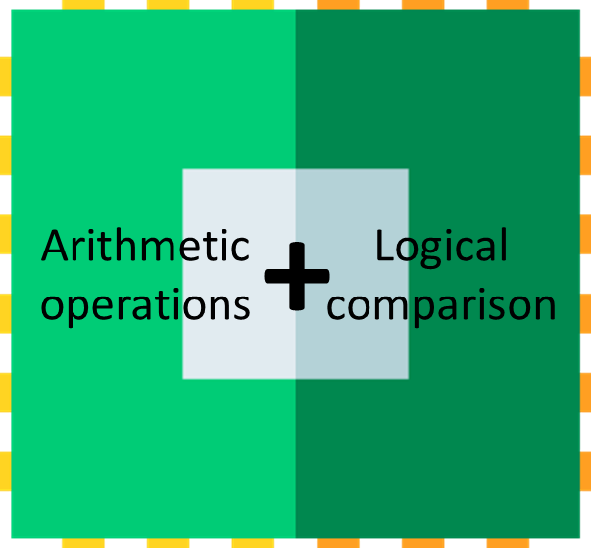
Common arithmetic operators
Arithmetic Logic Unit
Operator | Example | Meaning | Result
+ | x = 7 + 2 | Addition | 9

Slide 4
Common arithmetic operators
Arithmetic Logic Unit
Operator | Example | Meaning | Result
+ | x = 7 + 2 | Addition | 9
- | x = 7 - 2 | Subtraction | 5

Slide 5
Common arithmetic operators
Arithmetic Logic Unit
Operator | Example | Meaning | Result
+ | x = 7 + 2 | Addition | 9
- | x = 7 - 2 | Subtraction | 5
* | x = 7 * 2 | Multiplication | 14

Slide 6
Common arithmetic operators
Arithmetic Logic Unit
Operator | Example | Meaning | Result
+ | x = 7 + 2 | Addition | 9
- | x = 7 - 2 | Subtraction | 5
* | x = 7 * 2 | Multiplication | 14
/ | x = 7 / 2 | Division | 3.5

Slide 7
Common arithmetic operators
Arithmetic Logic Unit
Operator | Example | Meaning | Result
+ | x = 7 + 2 | Addition | 9
- | x = 7 - 2 | Subtraction | 5
* | x = 7 * 2 | Multiplication | 14
/ | x = 7 / 2 | Division | 3.5
^ | x = 7 ^ 2 | Exponentiation | 49

Slide 8
Common arithmetic operators
Arithmetic Logic Unit
Operator | Example | Meaning | Result
+ | x = 7 + 2 | Addition | 9
- | x = 7 - 2 | Subtraction | 5
* | x = 7 * 2 | Multiplication | 14
/ | x = 7 / 2 | Division | 3.5
^ | x = 7 ^ 2 | Exponentiation | 49
MOD | x = 7 MOD 2 | Modulus | 1
7 MOD 2
What is the remainder once you fit the number on the right into the number on the left as many times as possible?

Slide 9
Common arithmetic operators
Arithmetic Logic Unit
Operator | Example | Meaning | Result
+ | x = 7 + 2 | Addition | 9
- | x = 7 - 2 | Subtraction | 5
* | x = 7 * 2 | Multiplication | 14
/ | x = 7 / 2 | Division | 3.5
^ | x = 7 ^ 2 | Exponentiation | 49
MOD | x = 7 MOD 2 | Modulus | 1
7 MOD 2
What is the remainder once you fit the number on the right into the number on the left as many times as possible?
1

Slide 10
Common arithmetic operators
Arithmetic Logic Unit
Operator | Example | Meaning | Result
+ | x = 7 + 2 | Addition | 9
- | x = 7 - 2 | Subtraction | 5
* | x = 7 * 2 | Multiplication | 14
/ | x = 7 / 2 | Division | 3.5
^ | x = 7 ^ 2 | Exponentiation | 49
MOD | x = 7 MOD 2 | Modulus | 1
DIV | x = 7 DIV 2 | Integer division | 3
7 DIV 2
How many times does the number on the right fit into the number on the left?

Slide 11

Common arithmetic operators
Arithmetic Logic Unit
Operator | Example | Meaning | Result
+ | x = 7 + 2 | Addition | 9
- | x = 7 - 2 | Subtraction | 5
* | x = 7 * 2 | Multiplication | 14
/ | x = 7 / 2 | Division | 3.5
^ | x = 7 ^ 2 | Exponentiation | 49
MOD | x = 7 MOD 2 | Modulus | 1
DIV | x = 7 DIV 2 | Integer division | 3
7 DIV 2
How many times does the number on the right fit into the number on the left?
1
2
3

Slide 12
Common comparison operators
Arithmetic Logic Unit
Operator | Example | Meaning
= | 7 = 7 | Equal to

Slide 13
Common comparison operators
Arithmetic Logic Unit
Operator | Example | Meaning
= | 7 = 7 | Equal to
<> | 7 <> 5 | Not equal to

Slide 14
Common comparison operators
Arithmetic Logic Unit
Operator | Example | Meaning
= | 7 = 7 | Equal to
<> | 7 <> 5 | Not equal to
< | 5 < 7 | Less than

Slide 15
Common comparison operators
Arithmetic Logic Unit
Operator | Example | Meaning
= | 7 = 7 | Equal to
<> | 7 <> 5 | Not equal to
< | 5 < 7 | Less than
<= | 5 <= 5 | Less than or equal to

Slide 16
Common comparison operators
Arithmetic Logic Unit
Operator | Example | Meaning
= | 7 = 7 | Equal to
<> | 7 <> 5 | Not equal to
< | 5 < 7 | Less than
<= | 5 <= 5 | Less than or equal to
> | 7 > 5 | Greater than

Slide 17
Common comparison operators
Arithmetic Logic Unit
Operator | Example | Meaning
= | 7 = 7 | Equal to
<> | 7 <> 5 | Not equal to
< | 5 < 7 | Less than
<= | 5 <= 5 | Less than or equal to
> | 7 > 5 | Greater than
>= | 7 >= 7 | Greater than or equal to
Note: Different languages may use alternate symbols to represent these operators. For example, “not equal to” could be:
!=
<>
~=

Slide 18


